Slide 1
The building blocks of a model-driven design
PRESENTED BY:
Sergey Tantsyura
Maxim Nakhod
Date: December 5, 2019

Slide 2


Disclaimer
Content of this training is based on Domain-Driven Design, Tackling Complexity in the Heart of Software book by Eric Evans.
This book was published in 2003 and Eric Evans introduceв Domain-Driven Design term.
This book is the primary source of knowledge on Domain-Driven Design topic, though it may be a bit hard to read.

Slide 3

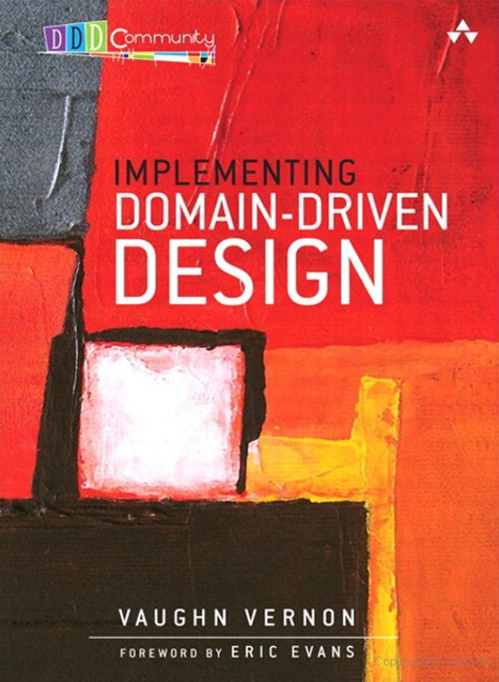
Other books on DDD topic
Domain-Driven Design Distilled by Vaughn Vernon | Implementing Domain-Driven Design by Vaughn Vernon

Slide 4

Presentation and examples on GitHub
This presentation and all examples can be found on GitHub:
https://github.com/tantsyurasergey/DDDTraining

Slide 5
Agenda
01
02
03
04
05
06

Slide 6
Q&A

